Slide 1


Insert relevant picture related to the topic
TGB2013/TFB2073/TEB2023_092 : Artificial Intelligence
WEEK 05
Informed Search: Greedy Best-First Search and A*
DEPARTMENT OF COMPUTING
FACULTY OF SCIENCE, MANAGEMENT & COMPUTING
© 2026 INSTITUTE OF TECHNOLOGY PETRONAS SDN BHD
All rights reserved. No part of this document may be reproduced, stored in a retrieval system or transmitted in any form or by any means (electronic, mechanical, photocopying, recording or otherwise) without the permission of the copyright owner.

Slide 2
RECAP FROM PREVIOUS LECTURE
Of 10,668 airport rows, 6,464 have a usable code and coordinates; of 67,663 route rows, 37,337 unique directed routes connect two usable airports. Every algorithm runs on this same graph, so the results are comparable. The cleaning rules are in utils/openflights.py; the note book only calls load_openflights.
Each edge carries the distance between its endpoints, computed once when the graph is built. Counting steps (BFS/DFS) and summing kilometres(UCS) are two different questions asked of the same graph.
BFS always returns the fewest hops(two legs on every query), UCS always returns the shortest distance, and DFS returns along, winding route because it follows the first neighbour deeply. Expanded-node counts are the stable measure of effort; runtimes vary from machine to machine. Every SearchResult has the same fields, which is why one loop and as_dict() build the whole table.
All nine paths use real routes and their costs equal the sum of their edge distances, so the metrics table can be trusted. An assert that fails stops the notebook with the name of the offending algorithm and query, deliberately loud.
BFS minimises the number of legs, so a two-leg route through a distant hub (KUL→AMS→KEF, 12,274 km) wins even though UCS finds a four-leg route (KUL→HKT→LED→HEL→KEF,11,461km) that is over 800 km shorter. Fewest legs and fewest kilometres are different objectives. DFS changes its answer as soon as the neighbour order changes, because it commits to the first branch it sees; it guarantees neither objective.
The figure is a longitude/latitude sketch, not a map projection, but it makes the difference visible: BFS jumps through one hub, UCS follows the geographically short chain, and DFS wanders.

Slide 3
LEARNING OUTCOMES
Before you start: Trace BFS, DFS and UCS(Lab 1) and explain what a priority queue does.
By the end, you can: define a heuristic and compute g, h and f for a state; trace Greedy Best-First Search and A⋆; decide whether a heuristic is admissible and why that matters; and read the effort versus-quality trade-off in Lab 2’s tables.
UCS found the shortest Kuala Lumpur-Keflavík route but expanded 1,851 airports without geographical guidance. Lab 2 adds a heuristic, an estimate of remaining distance, and measures its effect on search effort and route quality

Slide 4
TOPIC
Scenario. Improve the Lab1 planner by adding geographic knowledge while keeping a clear quality baseline.
Objective. Run GBFS and A⋆ with a Haversine heuristic, check admissibility, and measure quality against search effort.
Data. The Lab1 Open Flights files.
Notebook. all_experiments/lab02_informed_search_worked.ipynb and the shared all_experiments/utils/.

Slide 5
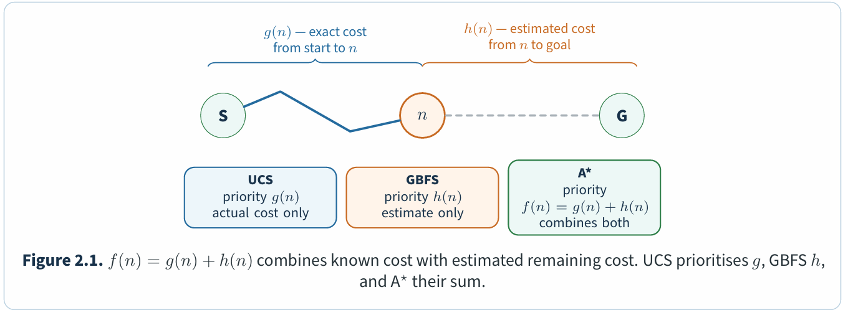
Three quantities on one path
Every informed method reasons about a frontier state n using up to three numbers:
Quantity | Meaning | Used by
g(n) | Exact cost of the cheapest known path from the start to n | UCS, A⋆
h(n) | Estimated cost from n to the goal — the heuristic | GBFS, A⋆
f(n) = g(n) +h(n) | Estimated total cost of a solution through n | A⋆
Figure 2.1 separates known cost from estimated remaining cost: UCS uses theformer, GBFSthelatter, and A⋆ both.
Notes:
Key idea
GBFS asks which frontier state looks closest to the goal. A⋆ also accounts for the cost already paid and, with asuitable heuristic, guarantees the cheapest path

Slide 6
The Haversine heuristic
A heuristic should be cheap to compute and use the same units as path cost. For kilometre-based routes, use the great-circle distance to the goal, whether or not a direct flight exists. The Haversine formula computes it from latitude–longitude pairs:
$$h\left(n\right)=2R arcsin\sqrt{\sin^{2}{\frac{∆φ}{2}+ \cos{φ_{n}\cos{φgoal\sin^{2}{\frac{∆⋋}{2}}}}}}$$
with R = 6371 km. The same formula gives every edge weight in the graph, so h and g are directly comparable. In Lab 2 the heuristic is a small function that fixes the goal and returns a function of the airport:
def heuristic_to(goal, weight=1.0):
def h(airport):
return weight * haversine_km(coords[airport]["latitude"], coords[airport]["longitude"], coords[goal]["latitude"], coords[goal]["longitude"])
return h
utils/core.py accepts any state-to-number callable, so changing the heuristic requires no changes to the search code.

Slide 7
Greedy Best-First Search
Greedy Best-First Search(GBFS) prioritises h(n) alone, ignoring the cost already paid. It finds routes in two or three expansions on the airline graph, but need not find cheap ones.
Worked example:
GBFS expands two airports for KUL-> LHR-> KEF: 12,500 km, 9% above the optimum. London looks close to Iceland, but the first leg alone exceeds the optimal route through Phuket, St Peters burg and Helsinki. Its NRT→CPT route is 6.7% too long; its SIN→EZE route happens to be optimal.
Common mistake
Because GBFS ignores g, a small h can conceal an expensive path. Route quality depends on the graph around the goal.

Slide 8
A*search
A⋆ prioritises f(n) = g(n) + h(n), balancing cost so far against estimated cost ahead. With a consistent h, this closed-set implementation returns the cheapest path, usually with far fewer expansions than UCS.
Worked example:
Suppose frontier state X has (g,h) = (5,3)andY has(1,5). GBFSchoosesX because3 < 5. A⋆ chooses Y because f(Y ) = 6 < f(X) = 8:thecheaperpathsofarisworththeextraestimated distance.
Implementation is one line away from UCS. In utils/core.py the three algorithms share best_first; only the priority differs:
def priority(state, g):
if mode == "ucs":
return g
if mode == "gbfs":
return h(state)
return g + h(state) # astar

Slide 9
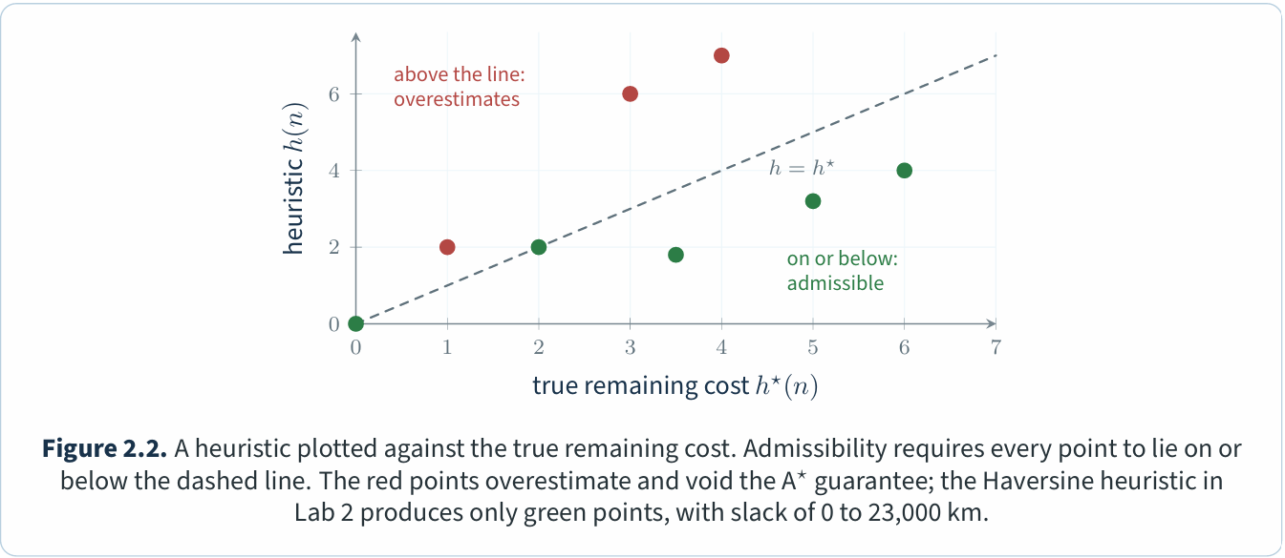
Admissibility and consistency
The optimality guarantee rests on one condition. A heuristic is admissible when it never overestimates the cheapest remaining cost:
h(n) ≤ h⋆(n) for every state n,
where h⋆(n) is the true cost of the cheapest path from n to the goal. A stronger and more convenient condition is consistency: for every edge n → n′ of cost c, h(n) ≤ c + h(n′). Consistency implies admissibility and guarantees that the first time A⋆ pops a state, it has found the cheapest path to it—which is what allows the closed-set implementation in utils to skip re-expansions.
Haversine is consistent by the triangle inequality on a sphere. Lab 2 also runs Dijkstra backwards from each goal to obtain h⋆, samples ten airports across the range, and checks h ≤ h⋆. In Figure2.2, every sampled point must lie on or below the diagonal.
Notes:
An inadmissible heuristic makes A⋆ behave like GBFS: it trusts the estimate too much and commits to a branch before the cost evidence justifies it. Admissibility keeps the g term in charge whenever the two disagree.

Slide 10
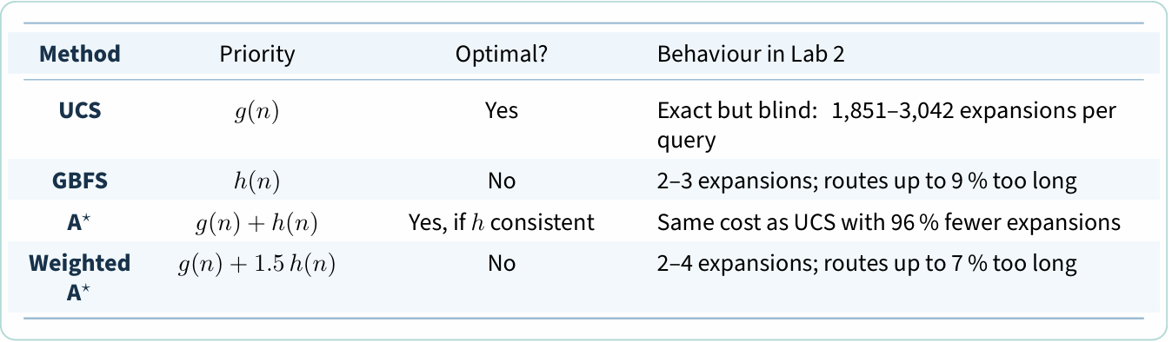
Weighted A*: trading the guarantee for speed
Weighted A⋆ uses g + wh with w > 1, trading the optimality guarantee for more goal-directed search. At w =1.5, Lab2 uses two, three and four expansions, with routes 7.1%, 0% and 0.8% above optimum. Inflating h can discourage useful detours away from the goal.
UCS, GBFS and A* side by side

Slide 11
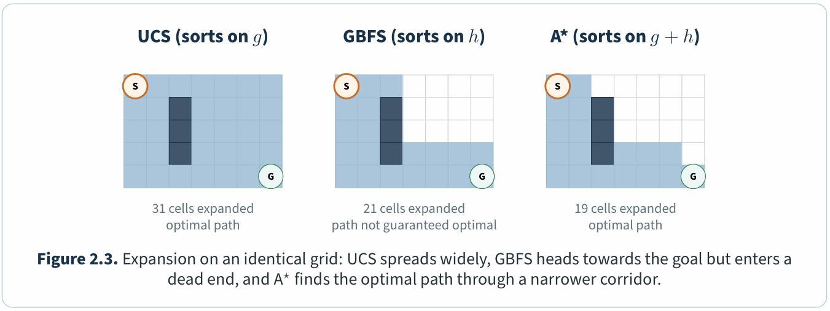
UCS, GBFS and A* side by side
Figure 2.3 visualises these expansion patterns on a shared grid.

Slide 12
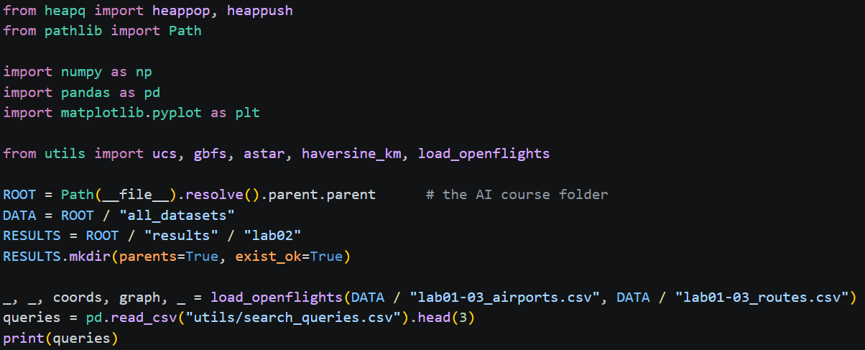
Heuristic Search on the Airline Network
Setup cell.

Slide 13
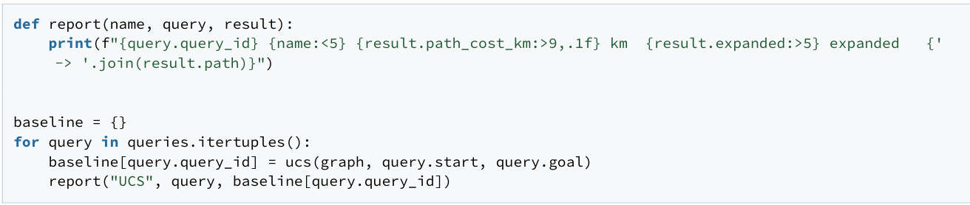
Heuristic Search on the Airline Network
Question 1 - Establish the baseline
Run UCS for the three standard queries. UCS is exact for non-negative costs, so its cost is the reference every informed method is judged against.
Reference output.
UCS reproduces the Lab 1 distances. These are the optimal costs; an informed method that returns more has traded quality for speed. The small report helper prints every result in the same shape, so the rows below line up with these.

Slide 14
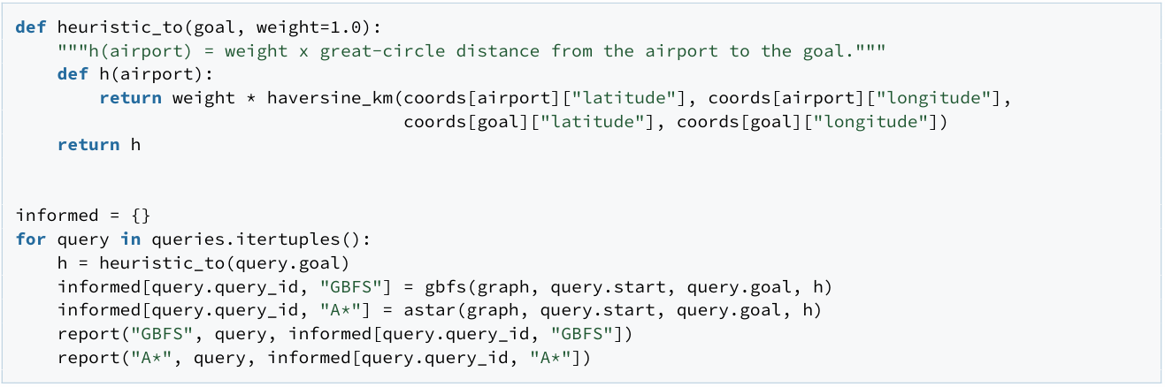
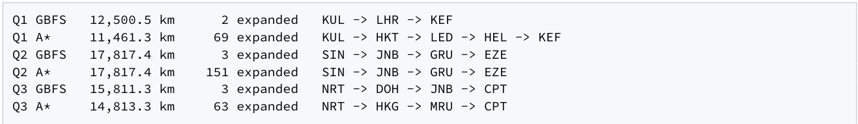
Heuristic Search on the Airline Network
Question 2 - Implement the heuristic and run GBFS and A⋆
Use the great-circle distance from the current airport to the goal as h(n). GBFS orders the frontier by h alone; A⋆ by g +h. Write the heuristic as a function that fixes the goal, then run both algorithms.
Reference output.
A⋆ returns exactly the UCS cost on every query while expanding far fewer states. GBFS expands only a handful of states, but two of its three routes are longer because it ignores the distance already travelled. heuristic_to returns a function: the algorithms in utils accept any callable that maps a state to a number.

Slide 15
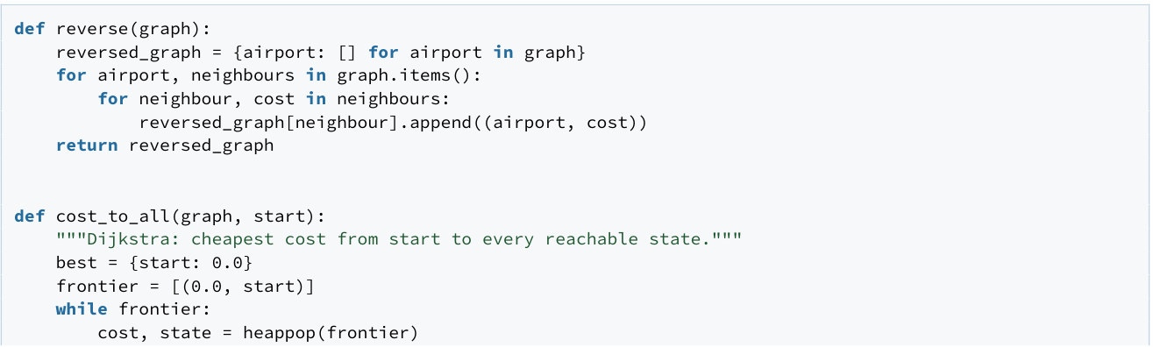
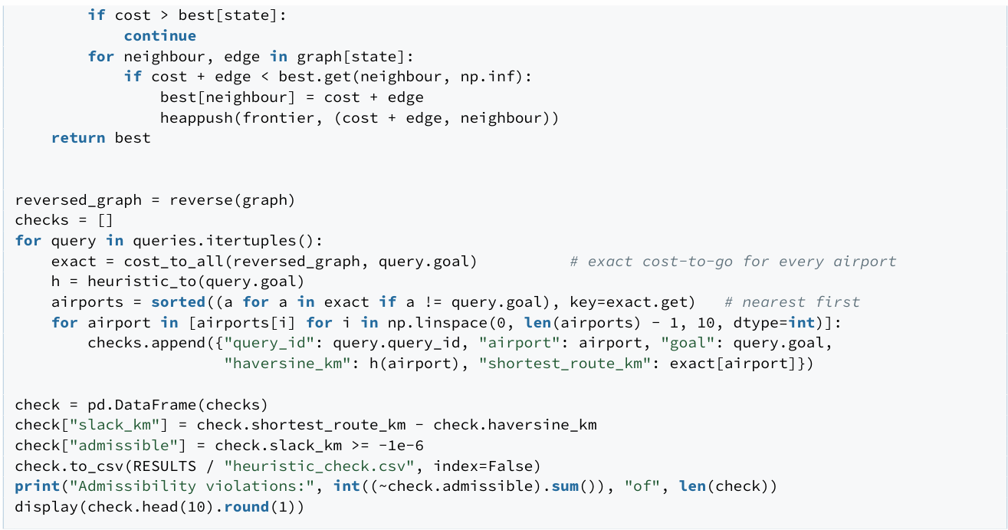
Heuristic Search on the Airline Network
Question 3 - Check admissibility empirically
An admissible heuristic never overestimates the true remaining cost. Run Dijkstra once on the reversed graph to get the exact cost from every airport to the goal, then compare h with that exact cost for ten airports spread across the range. Save heuristic_check.csv.

Slide 16
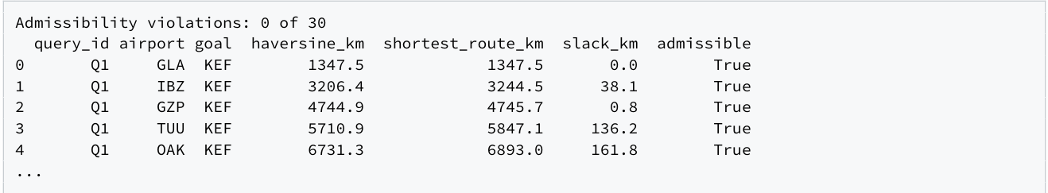
Heuristic Search on the Airline Network
Reference output.
Zero violations in thirty checks: the slack column is never negative. Haversine is admissible and consistent by the triangle inequality: direct distance cannot exceed any routed distance, or one flight plus the remaining direct distance. The table is an empirical check; the geometry is the guarantee. Reversing the graph turns “cost from the goal” into “cost to the goal”, which is what h estimates.

Slide 17
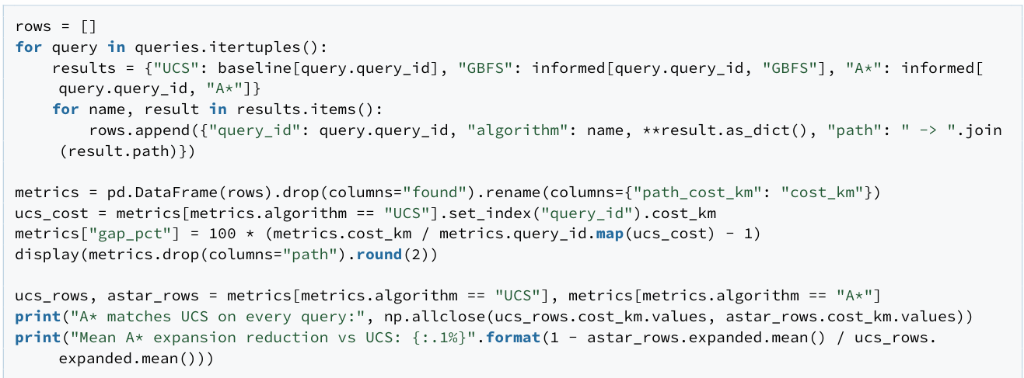
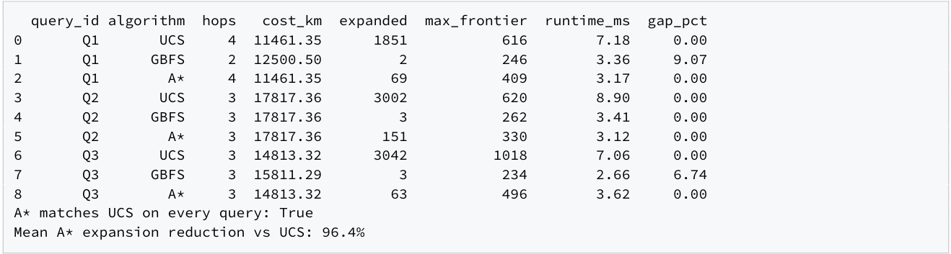
Heuristic Search on the Airline Network
Question 4 - Compare the methods
Put cost, hops, expanded nodes, maximum frontier and runtime for UCS, GBFS and A⋆ in one table, add the optimality gap relative to UCS, and save metrics.csv.
Reference output.
A⋆ keeps the UCS cost(gap 0%) while expanding roughly 96% fewer states. GBFS is the cheapest to run but returns routes up to 9% longer. The consistent Haversine heuristic buys speed without giving up optimality; greed buys more speed by giving it up.

Slide 18
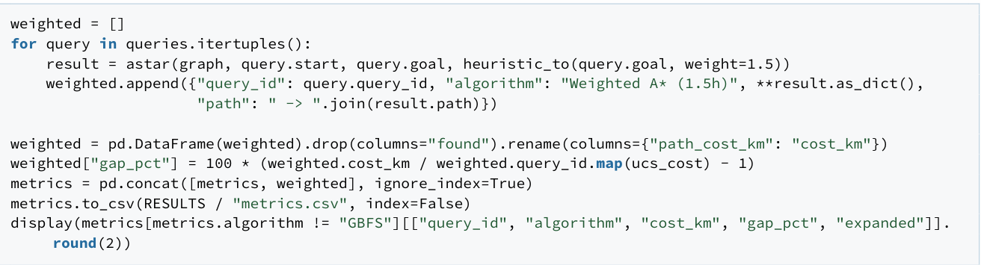
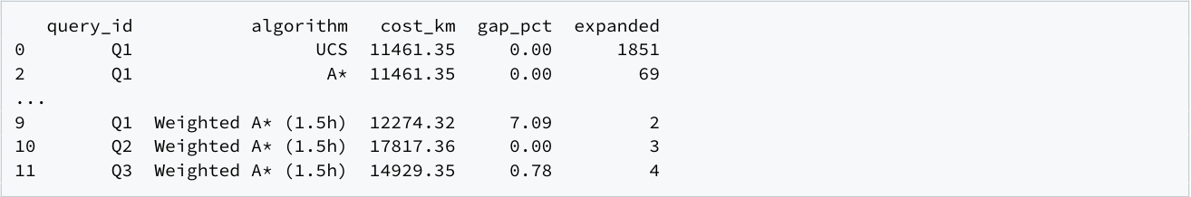
Heuristic Search on the Airline Network
Question 5-Stress the guarantee
Repeat the queries with the inflated heuristic 1.5h (weighted A⋆). Explain when the returned cost changes.
Reference output.
Multiplying h by 1.5 makes it inadmissible: it can now overestimate the remaining distance, so a route that looks closer to the goal is expanded first and returned. The cost changes when the optimal route detours through airports that are geographically further from the goal than a rival hop (Q1andQ3); when the optimal route already heads straight for the goal(Q2) nothing changes. Expansions fall to a handful; the price is a route up to 7% longer.

Slide 19
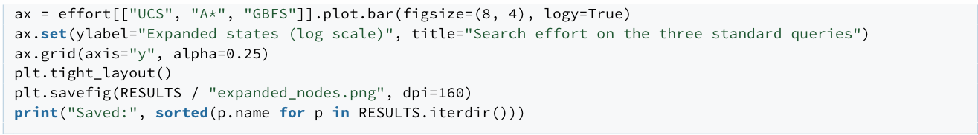
Heuristic Search on the Airline Network
Question 6- Save the evidence
Save an expanded-nodes figure for UCS, GBFS and A⋆. The two tables were saved above.
Reference output.
Expanded-state counts are the primary effort measure; wall-clock times depend on the machine and should not be compared across computers.

Slide 20
Summary
UCS is “blind but safe” - it finds the most cheapest path, but by doing a lot of work.
GBFS is "fast but risky“ - it does less work, but can sometimes give you the wrong path.
A* is the best combination of both - as accurate as UCS, and as fast as GBFS, as long as the heuristic does not lie (remains admissible).
Weighted A* intentionally lets the heuristic lie to get even more speed, but for that, you have to give up the guarantee of correctness.

Slide 21
THANK YOU
LECTURER’S NAME
DEPARTMENT OF COMPUTING
FIZA_24004757@UTP.EDU.MY
Lab 01-01-10: Data Analytic Lab

